Slide 1
MACHINE FAILURE PREDICTION
EXCELR
PRESENTED BY
MULLAPUDI VENKATA PRABHU KARTHIK
AATIF ZEYA
RAUT NAMRATA BALASAHEB
SINDHU
Guided by Munmun Bhagat

Slide 2
BUSINESS OBJECTIVE
In industries, re-evaluating their maintenance schedules is necessary for this digitalization era as smart as possible for production enhancements. Predictive maintenance offers great opportunities to businesses for a smarter and more digital facility. Using this dataset our objective is to predict when the machine is more likely to fail.

Slide 3
PROJECT FLOW
DATA COLLECTION
EDA
MODEL BUILDING & EVALUATION
MODEL DEPLOYMENT

Slide 4
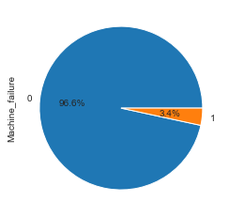
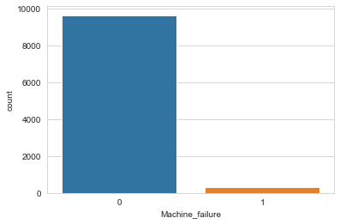
EDA MACHINE FAILURE PIE CHART AND COUNT PLOT

Slide 5
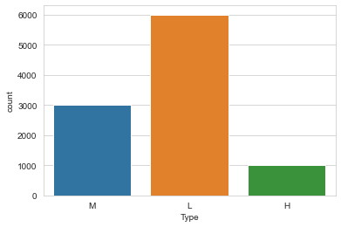
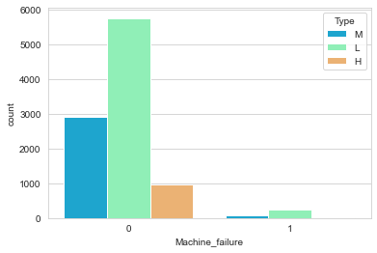
VALUES IN ‘TYPE’ COLUMN / WITH RESPECT TO TARGET COLUMN

Slide 6
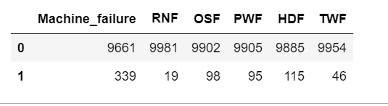
VALUE COUNTS OF SUBGROUPS OF MACHINE FAILURE

Slide 7
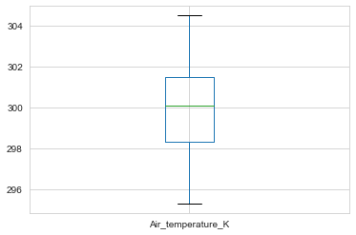
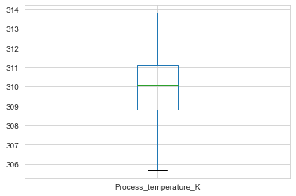
OUTLIER DETECTION USING BOXPLOT

Slide 8
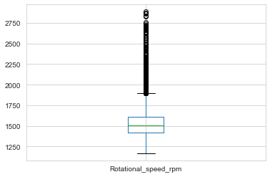
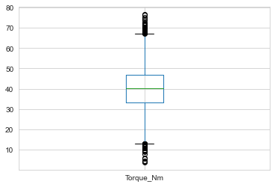
WE CAN CLEARLY SEE SOME DATA POINTS ABOVE UPPER FANCE IN ROTATIONAL SPEED AND IN TORQUE THERE ARE DATA POINTS BELOW LOWER FANCE AND ABOVE UPPER FANCE.

Slide 9
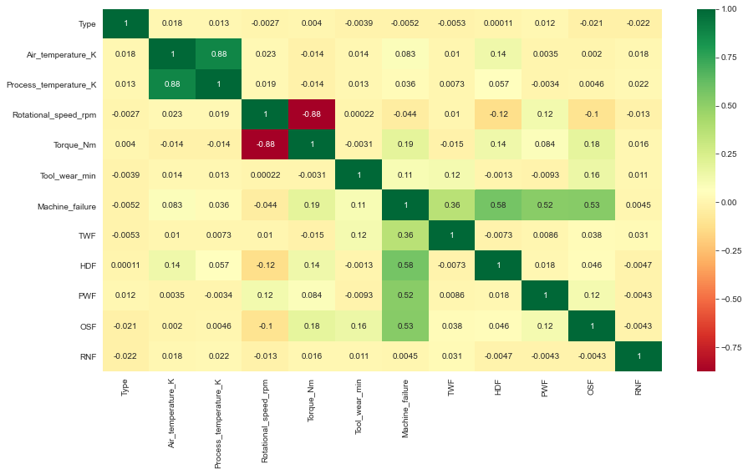
CORRELATION USING HEATMAP

Slide 10



DATA SEGREGATION
label_encoder object knows how to understand word labels.
Encode labels in column 'Type’.
Defined X – independent variables.
Defined Y – target variable (Machine Failure

Slide 11
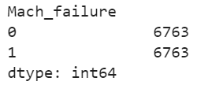
DATA TRANSFORMATION
Applied StandardScaler to standardize the model.
Applied train_test_split to split the data.
Applied SMOTE as the data was imbalanced.

Slide 12
REPORT GENERATION USING AUTOMATED LIBRARIES
PANDAS_PROFILING
SWEETVIZ_REPORT

Slide 13
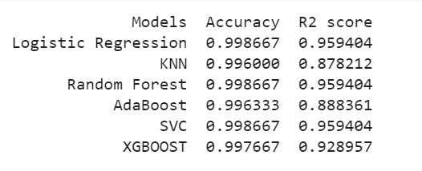

Slide 14
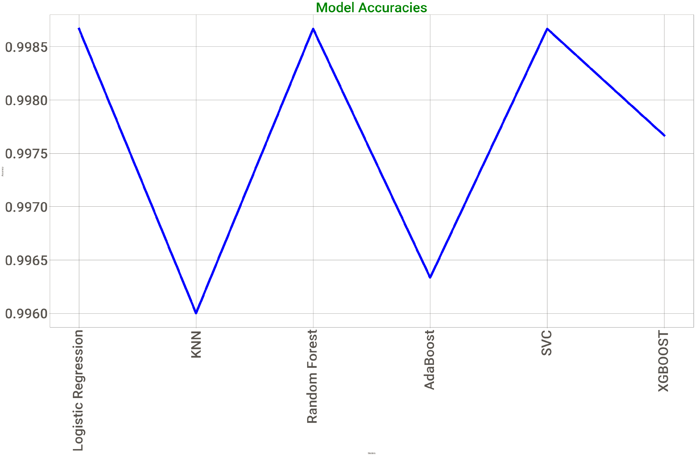

Slide 15
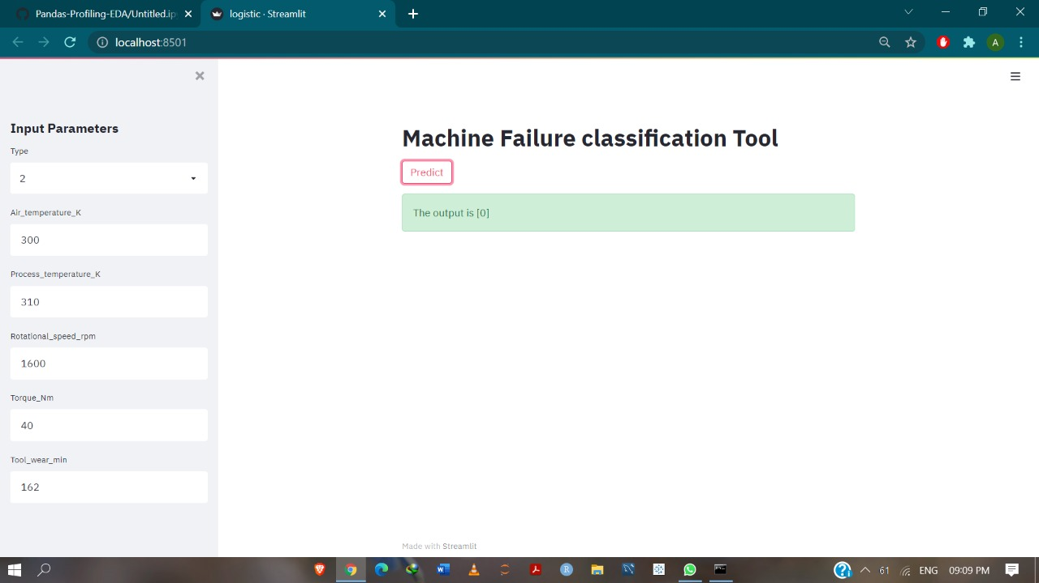

Slide 16
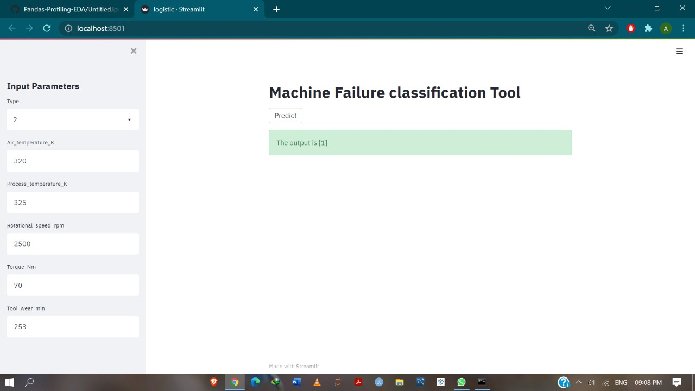

Slide 17
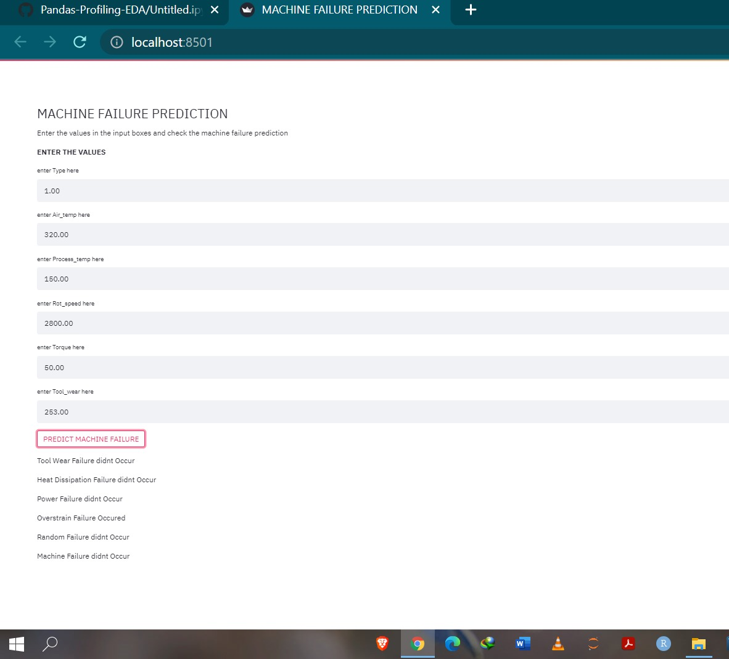

Slide 18
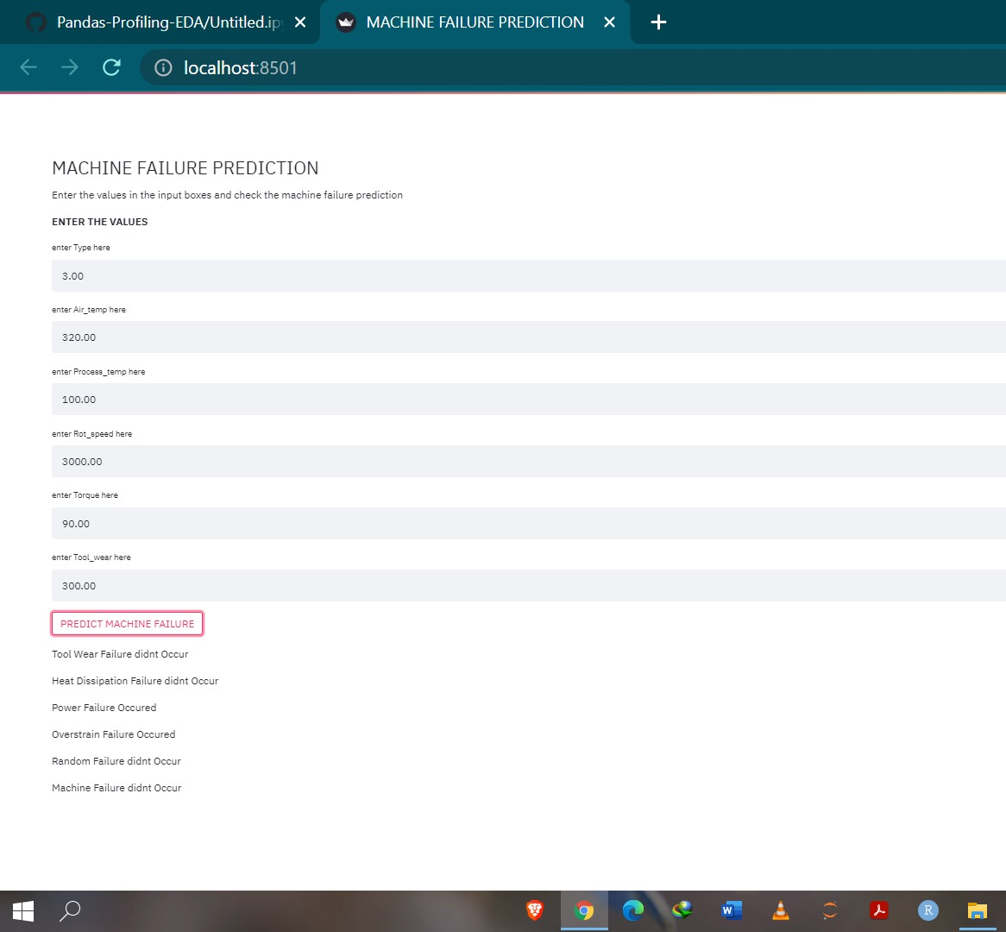

Slide 19
THANK YOU

